Slide 1
Department of Computer Engineering News Web Application Evaluation using Machine Learning Algorithm
Team Members:
1. Praful Kalhapure
2. Vaishnavi Dobe
3. Rutika Chougale
4. Varsha Chavan
Guided by:
Dr. Sunil D. Rathod

Slide 2
Agenda
1.Introduction
2.Liturature Survey
3.Taxonomy Chart
4.Motivation
5. Problem Statement
6. Objectives and Scope
7.Proposed System Architecture
8. Methodology / User Interfaces
9. Mathematical Model
10. Software Design (DFD/UML/ER diagrams)
11.H/W and S/W Requirements
12. Project Cost Estimation
13.Planning and Scheduling of Project(Gantt Chart)
14.Risk Involved
15.Social Aspect
16.Results
16.Conclusion
17.References

Slide 3
Introduction
The aim of this system is to make better suggestions about design of website or web application by analyzing users’ opinion and sentiments.
It will also help to identify issues related to content quality, relevance, and accuracy of the web app.

Slide 4
Literature Survey
Sr. No. | Title of Paper | Year | Author | Key Points | Limitations | Gap identified
1 | A Comprehensive Review on Online News Popularity Prediction using Machine Learning Approach | 2019 | Anurag Jain, Chetan Agrawal | News articles online news Popularity prediction | 1. Multilingual . Content | Ambiguity
2 | Website Evaluation Using Opinion Mining | 2021 | P Keerthana, B Meghana, P Akshaya | Social networking Websites Internet sites Opinion mining Rating | 1.Lack of human understanding. 2.Context understanding | Negation handling
3 | A review on sentiment analysis from social media platforms | 2023 | Margarita Rodríguez-Ibanez ´ a,* , Antonio Casanez-Ventura ´ b , F´elix Castejon-Mateos ´ b , Pedro-Manuel Cuenca-Jim´enez b | Sentiment analysis Social media Twitter | Limited to text 2. By evolving language and trends | 1.Context Sensitivity.

Slide 5


Taxonomy Chart
Parameters System | Multiple Website Evaluation | Detailed Design report | Predict the Changes | Ease of access
A Comprehensive Review on Online News Popularity Prediction using Machine Learning Approach
Website Evaluation Using Opinion Mining
A review on sentiment analysis from social media platforms
Proposed System

Slide 6
Motivations
The foremost motivation is the desire to prioritize user satisfaction by understanding their sentiments and preferences. Evaluating the web sites might make it greater green and may offer a better way to choose the better website.
The ability to make informed decisions backed by data and user opinions allows organizations to continuously adapt and improve, staying relevant in a dynamic news environment.

Slide 7
Problem Statement
To develop News Website/Web Application using opinion mining for suggesting better design and news contents.

Slide 8
Objectives
Improve the overall user experience by identifying and addressing user concerns related to website design, content quality, and usability.
Ensure that news articles and content align with user preferences and interests, enhancing content relevance and engagement.
Utilize user feedback and sentiment analysis to drive data-driven decision-making for continuous improvements in website design and content.

Slide 9
Scope
System improvement is likewise taken into consideration as a system subsidized with the aid of using engineering techniques. We have attempted to incorporate & expand new debris for our training debris were observed now no longer all through the coding however additionally all through the analysis, layout phases & in documentation.
Website evaluated the use of opinion mining assignment is taken into consideration as an enlargement of commercial enterprise relations.

Slide 10
Proposed System Architecture

Slide 11
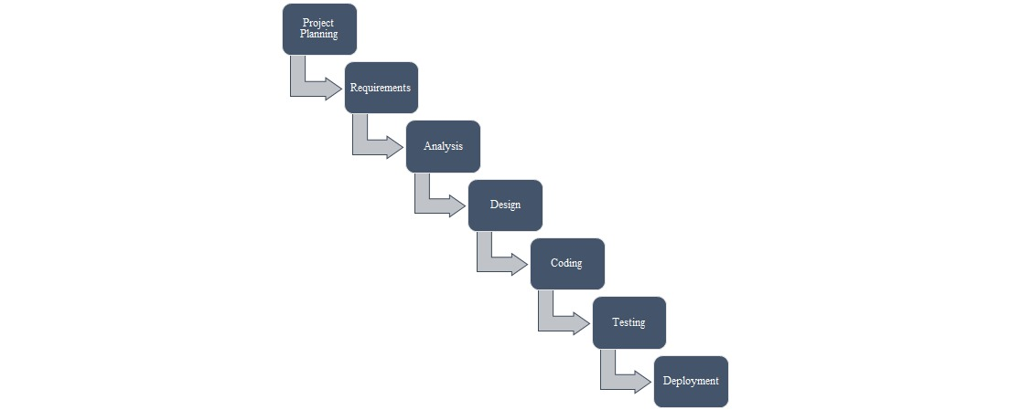
Methodology
Fig. Waterfall Model Diagram

Slide 12
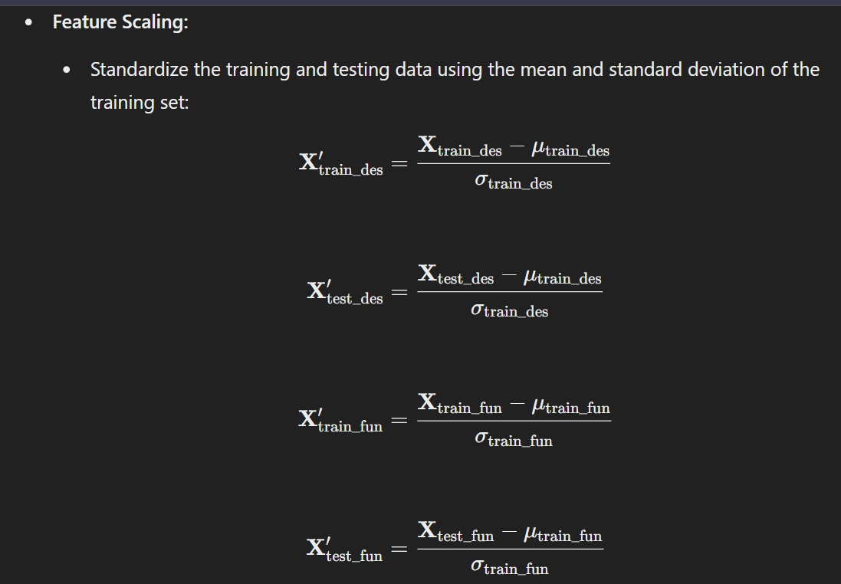
Mathematical Model(1)

Slide 13
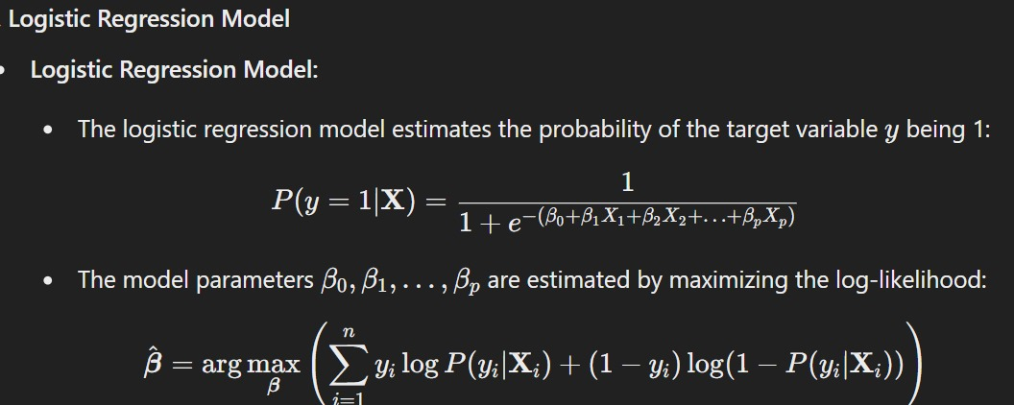
Mathematical Model(2)

Slide 14
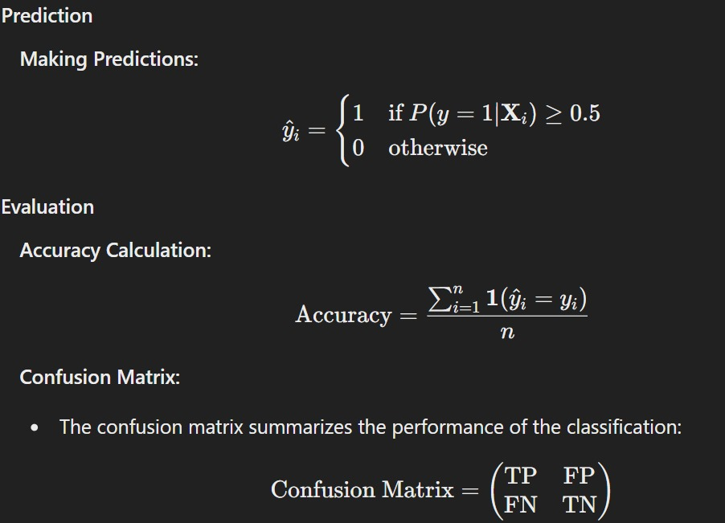
Mathematical Model(3)

Slide 15
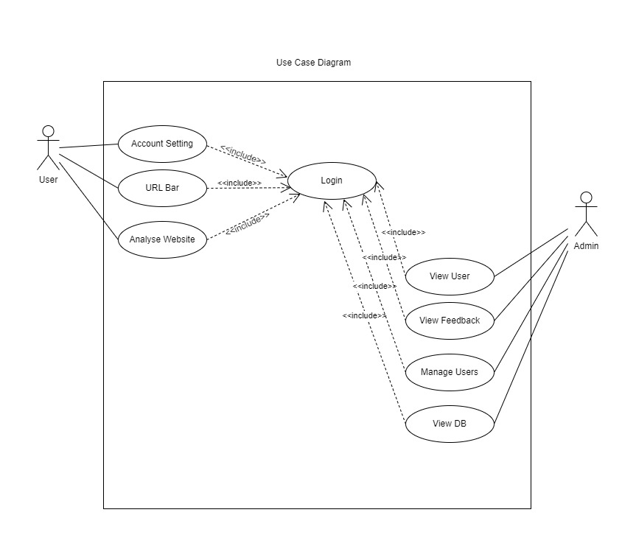
Software Design (1)
Fig. Use Case Diagram

Slide 16
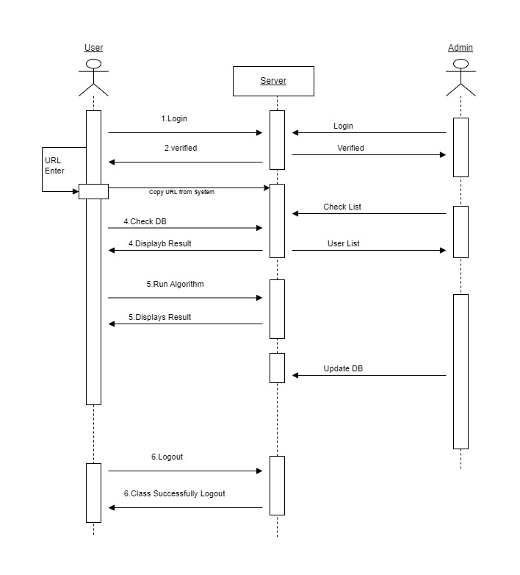
Software Design (2)
Fig. Sequence Diagram

Slide 17
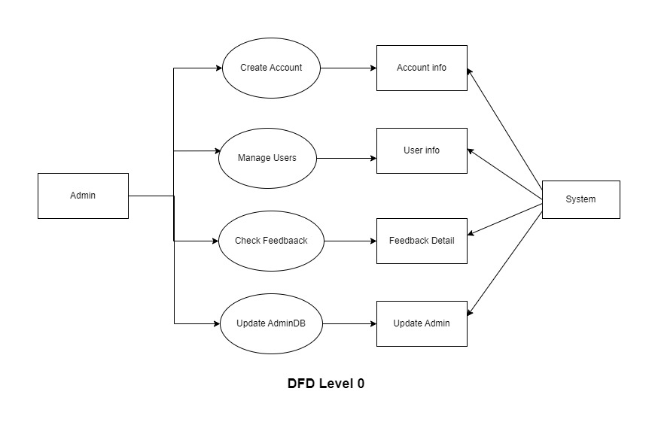
Software Design (3)
Fig. DFD level 0

Slide 18
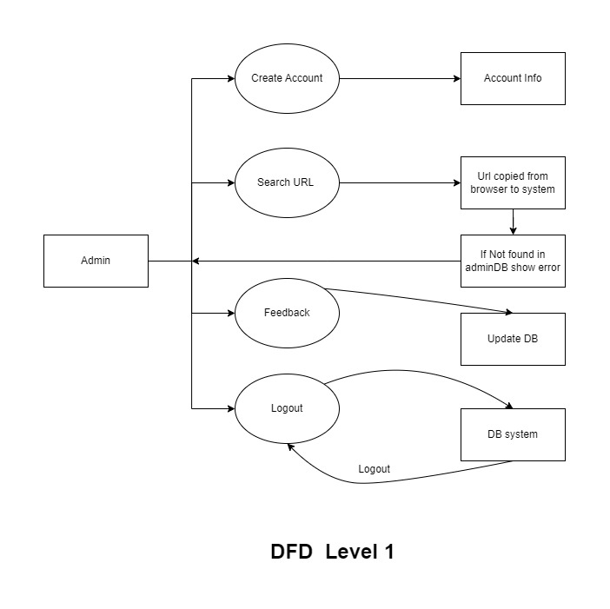
Software Design (4)
Fig. DFD level 1

Slide 19
S/W Requirements
Sr. No. | Components | Specification
1 | Operating System | Windows 10 or later / MacOS 10.14 or later
2 | Technology | HTML, CSS, JavaScript, Python
3 | Tool | Visual Studio, Text Editor
4 | Database | SQLITE

Slide 20
H/W Requirements
Sr. No. | Components | Specification
1 | Processor | Intel i3 7th Gen or better, Apple M1
2 | Memory | 8 GB RAM
3 | Network Interface | Wi-Fi 5 (802.11ac)

Slide 21
Project Cost Estimation
Estimate Effort
Effort(E) Use the Home COCOMO equation to estimate effort(E):
For the “Organic” mode , the formula is:
E=a*(K LOC)b
Where:
a = 2.4(Constant for the “Organic” mode)
b =1.05(Constant for the “Organic” mode)
KLOC= Estimated lines of code in kilos=5
Calculate E:
E=2.4*(5)^{1.05} =26.83Person-Months(PM)

Slide 22
Project Cost Estimation(2)
Estimate Development Time
Duration(in months) = Effort(in PM)/ Team Size
Duration(in months) = 26.83/ 4 = 6.70 Months
Estimate Cost
Cost = Efforts(in PM)* Average Monthly Salary
Cost=26.83 PM* Rs 2500 = 67,075

Slide 23
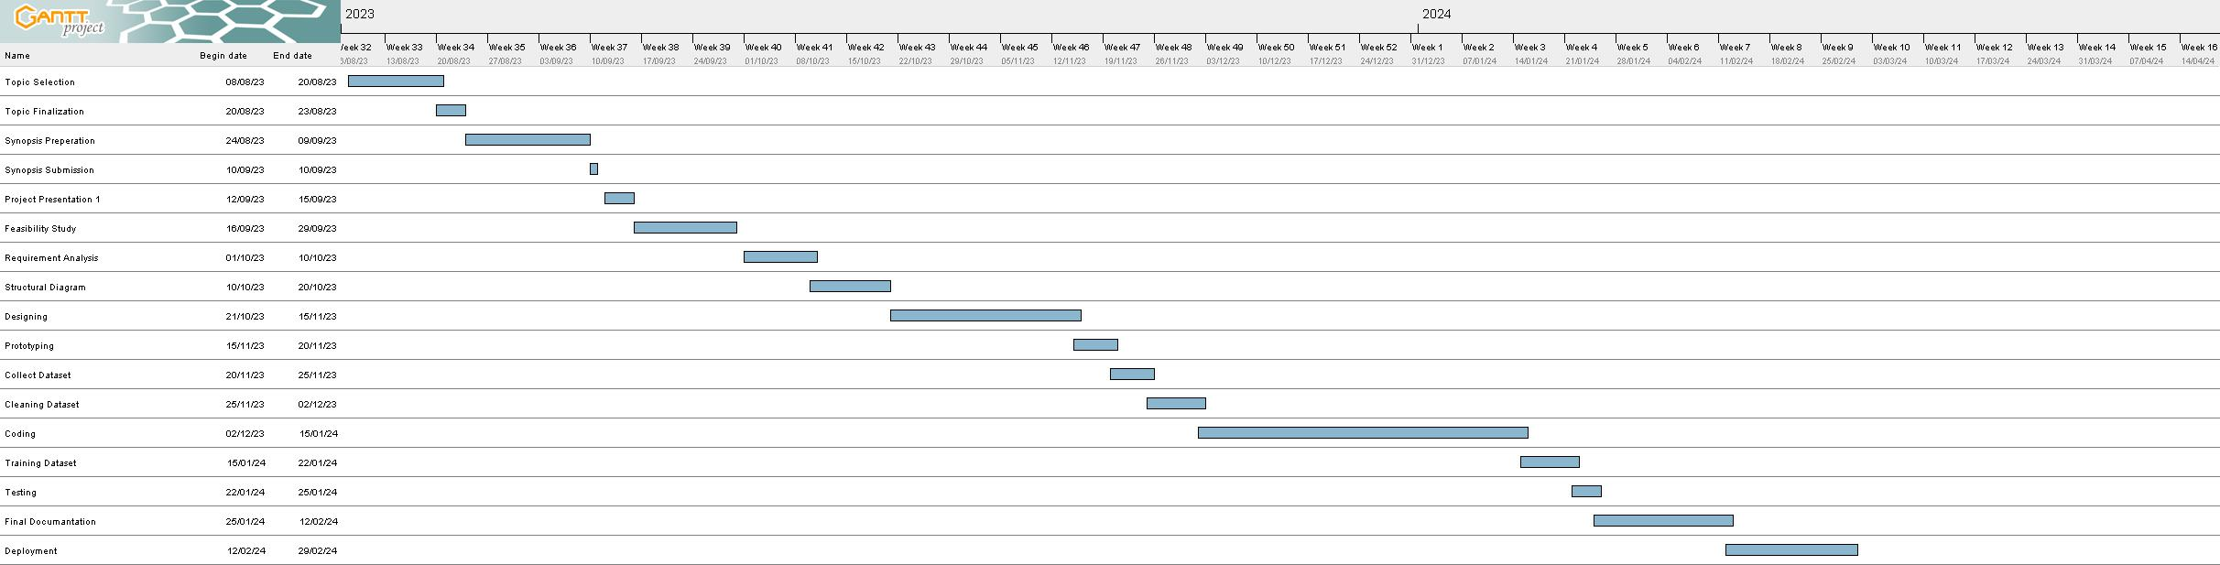
Planning and Scheduling of Project(Gantt Chart)

Slide 24
Risk Involved
If the design of website is more complex, then our model will require more time to analyse it.
If the model is not train well with the algorithms, then new dataset will not work properly because of this model accuracy will be decreased and we will not get the exact solution of the model.

Slide 25
Social Aspect
Data Collection and Preprocessing
Sentiment Analysis
User Experience and Feedback Analysis
Community Sentiment Analysis

Slide 26
Result (1)

Slide 27
Result (2)

Slide 28
Result (3)

Slide 29
Result (4)

Slide 30
Result (5)

Slide 31
Conclusion
The development of a News Website/Web application evaluation system using opinion mining offers significant potential for
Enhancing user experiences,
Content quality, and
Ethical standards in the digital news landscape.

Slide 32
References
Priyanka Rathord Dr. Anurag Jain Chetan Agrawal, ‘A Comprehensive Review on Online News Popularity Prediction using Machine Learning Approach’
P KEERTHANA#1, B MEGHANA#2, P AKSHAYA#3, ‘WEBSITE EVALUATION USING OPINION MINING’
Margarita Rodríguez-Ibanez ´ a,* , Antonio Casanez-Ventura ´ b , F´elix Castejon-Mateos ´ b , Pedro-Manuel Cuenca-Jim´enez b ‘A review on sentiment analysis from social media platforms’

Slide 33
Thank You !!

